Slide 1

CSE (H) with specialization in Machine Learning and Artificial Intelligence
Soft Computing (20CST-345)
Chapter -3.3
Introduction to Genetic Algorithms
By: Dr. Monika Singh E11032
DISCOVER . LEARN . EMPOWER

Slide 2
Course Objectives
To introduce soft computing concepts and techniques of artificial neural networks, fuzzy sets, fuzzy logic and genetic algorithms
To understand the various techniques from the application point of view.
To analyze various soft computing techniques and decide the technique to be used in a particular problem situation.
To implement soft computing based solutions for real-world problems
DISCOVER . LEARN . EMPOWER

Slide 3
Course Outcomes
CO1 | Identify and describe soft computing techniques and their roles in building intelligent. Machines | 1
CO2 | Recognize the feasibility of applying a soft computing methodology for a particular problem. | 2,4
CO3 | Apply fuzzy logic and reasoning to handle uncertainty and solve engineering problems, genetic algorithms to combinatorial optimization problems and neural networks to pattern classification and regression problems. | 3
CO4 | Effectively use modern software tools to solve real problems using a soft computing approach. | 3
CO5 | Evaluate various soft computing approaches for a given problem. | 4
DISCOVER . LEARN . EMPOWER

Slide 4
Table of Contents
History of Genetic Algorithms (GA), Fundamentals of Genetic Algorithms, Encoding, Operators of Genetic Algorithm, Basic Genetic Algorithm.
DISCOVER . LEARN . EMPOWER

Slide 5
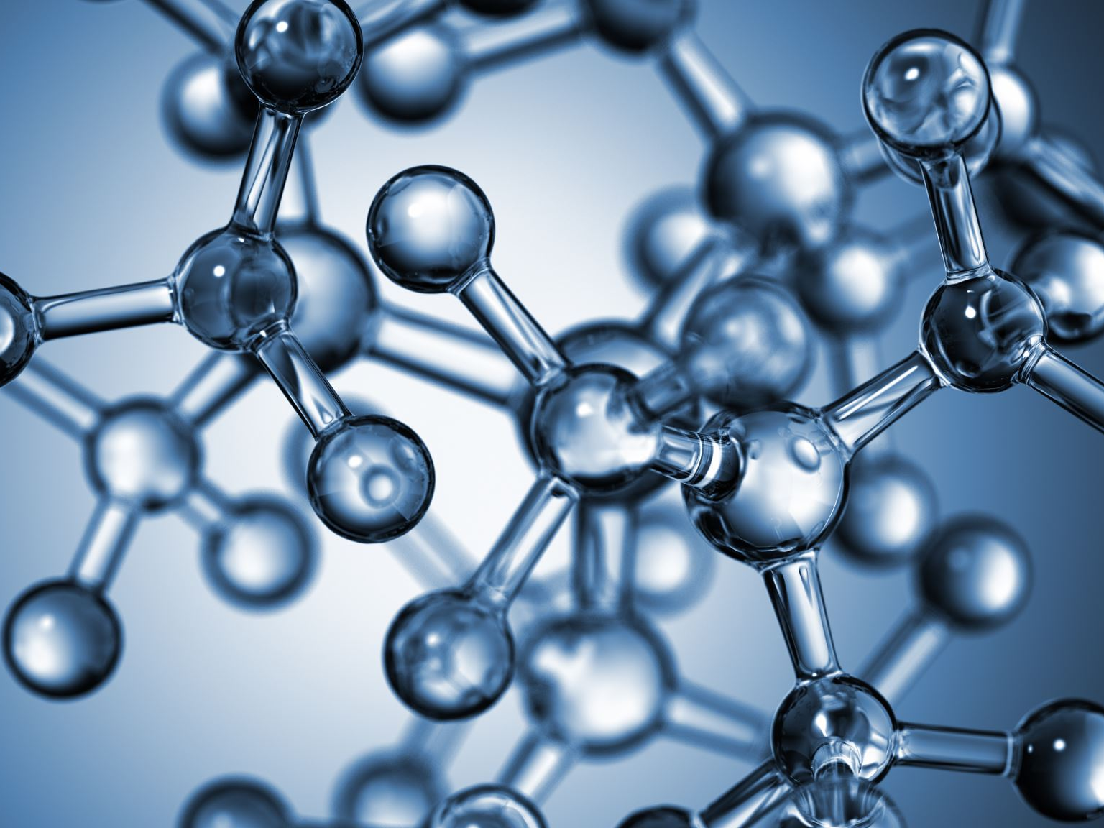
Introduction to Genetic Algorithms
DISCOVER . LEARN . EMPOWER

Slide 6
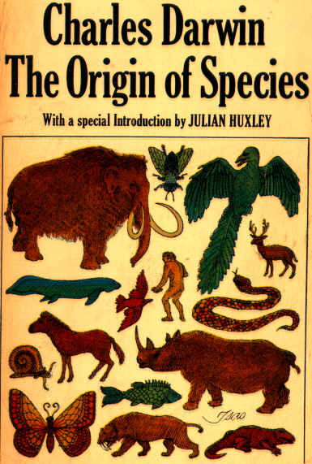
General Introduction to GAs
Genetic algorithms (GAs) are a technique to solve problems which need optimization.
GAs are a subclass of Evolutionary Computing and are random search algorithms.
GAs are based on Darwin’s theory of evolution and natural selection.
History of GAs:
Evolutionary computing evolved in the 1960s.
GAs were created by John Holland in the mid-1970s.
DISCOVER . LEARN . EMPOWER

Slide 7
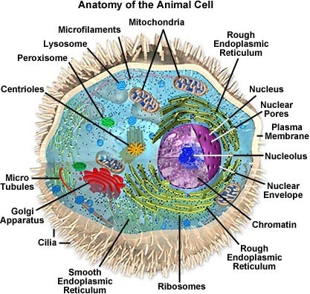
Biological Background – The Cell
Every cell is a complex structure of many small “factories” working together.
The center of this all is the cell nucleus.
The nucleus contains the genetic information.
DISCOVER . LEARN . EMPOWER

Slide 8
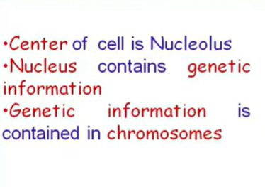
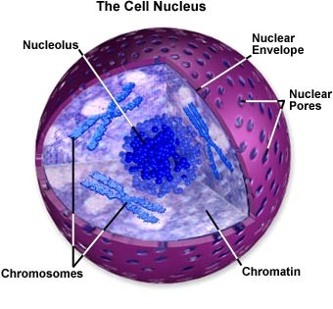

Slide 9
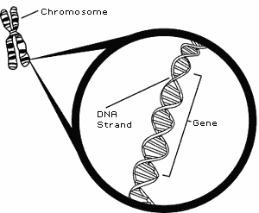
Biological Background – Chromosomes
Genetic information is stored in the chromosomes.
Each chromosome is build of DNA.
Chromosomes in humans form pairs.
There are 23 pairs.
The chromosome is divided in parts: genes.
Genes code for properties.
The posibilities of the genes for one property is called: allele.
Every gene has an unique position on the chromosome: locus.
DISCOVER . LEARN . EMPOWER

Slide 10
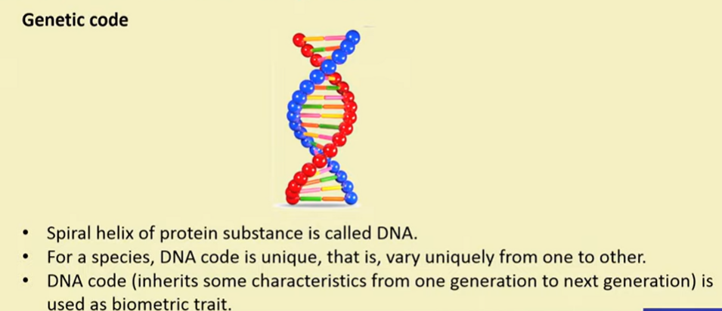

Slide 11
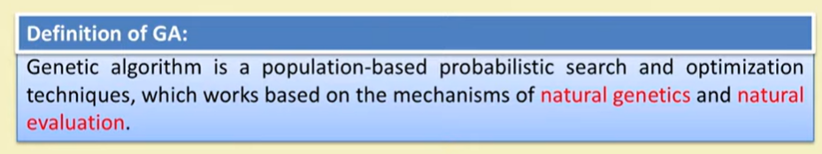
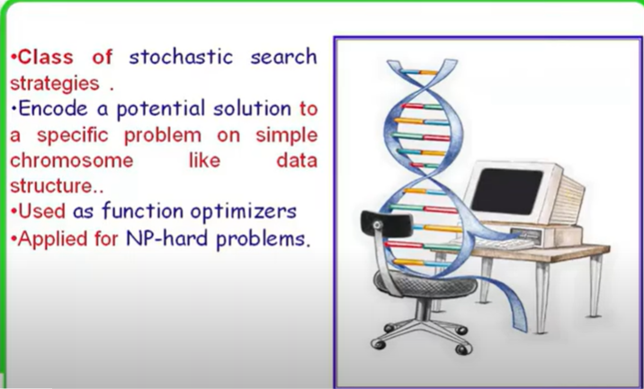

Slide 12
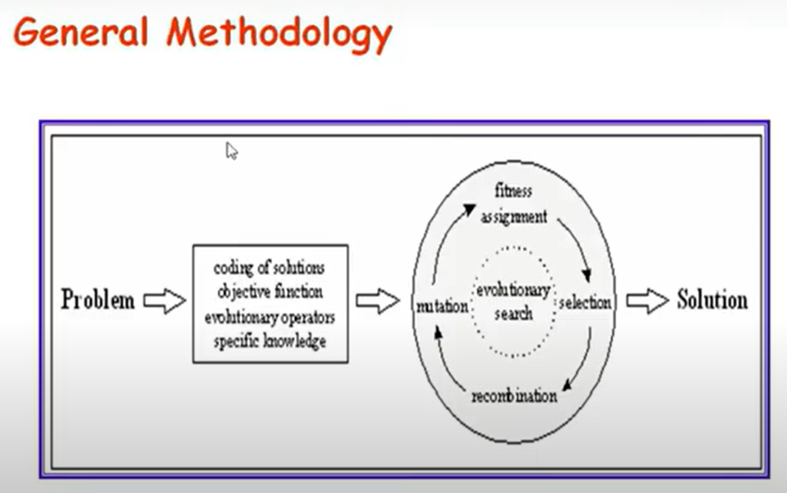

Slide 13
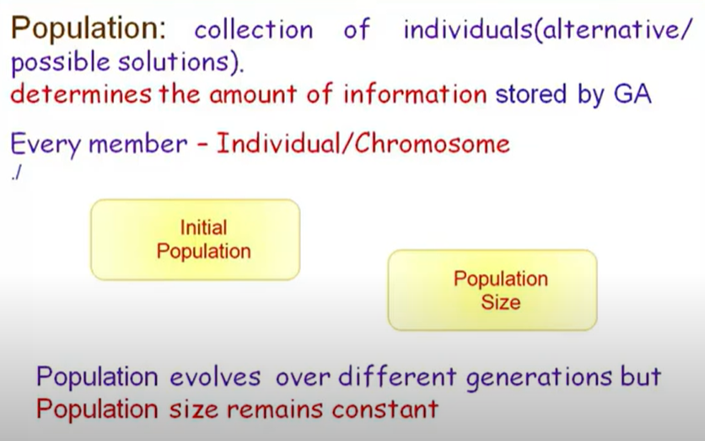
Basic Terminology

Slide 14
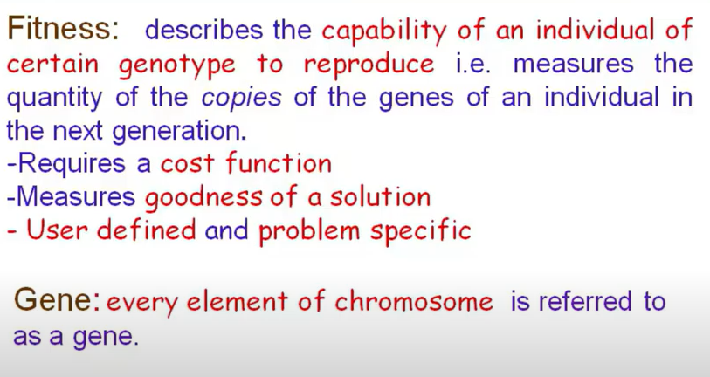
Basic Terminology

Slide 15
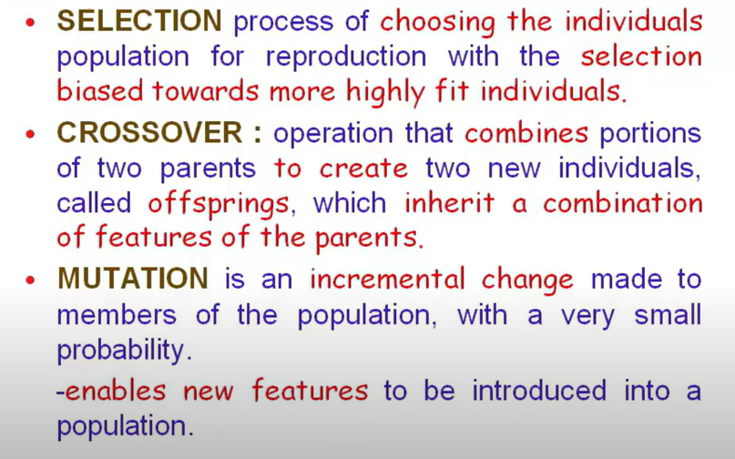
Basic Terminology

Slide 16
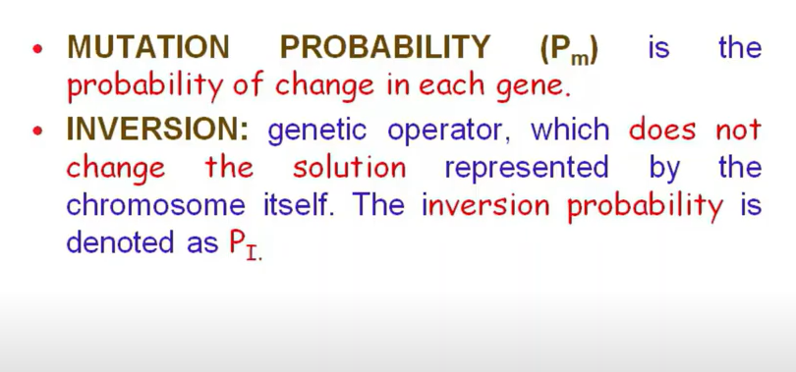
Basic Terminology

Slide 17
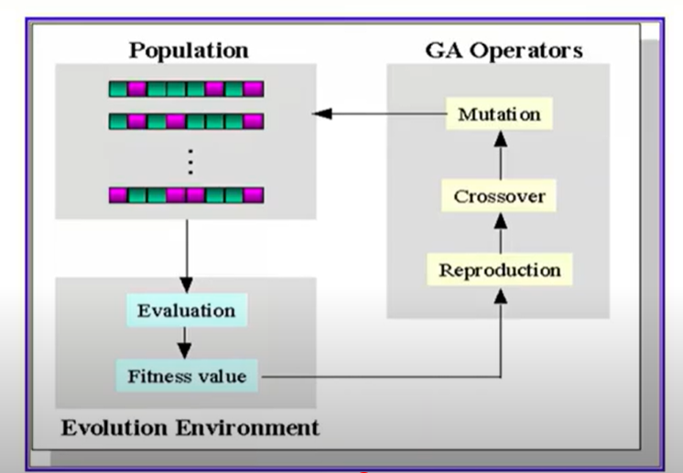
Genetic Algorithm Methodology

Slide 18
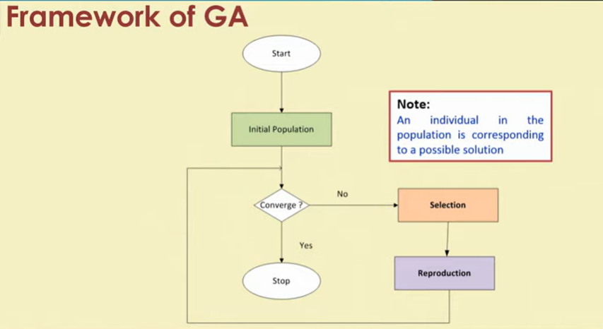

Slide 19
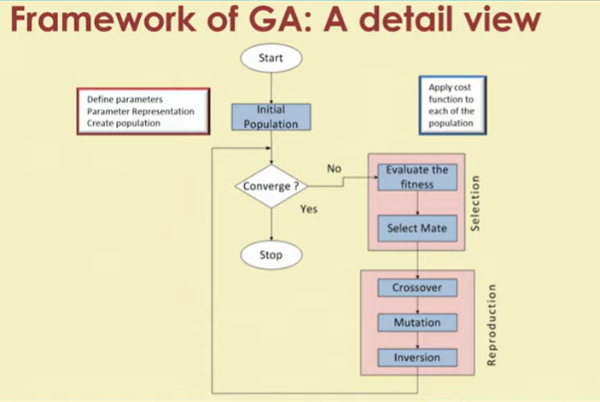

Slide 20
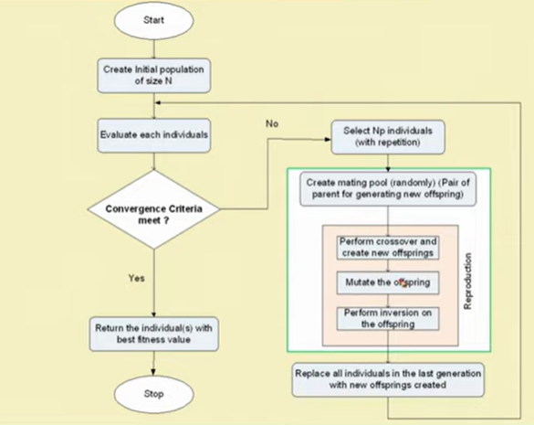

Slide 21
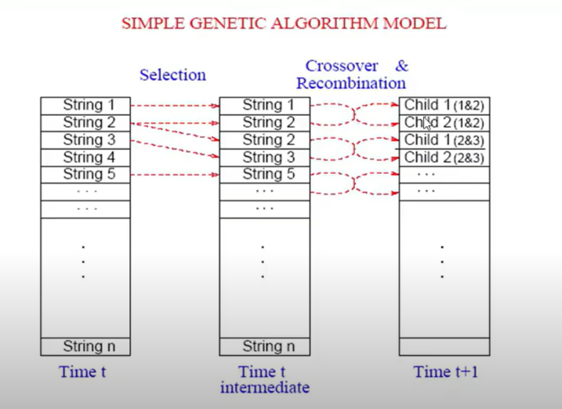

Slide 22
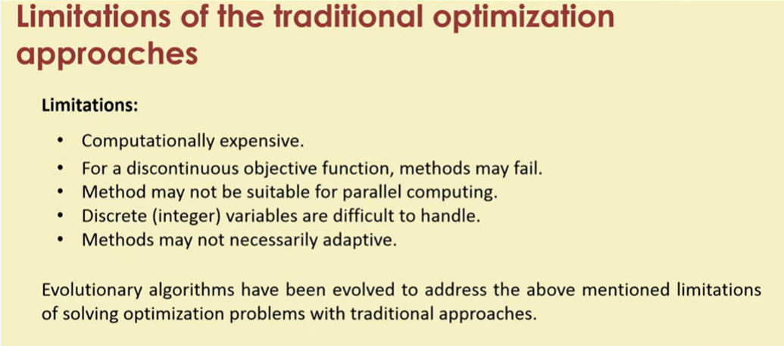

Slide 23
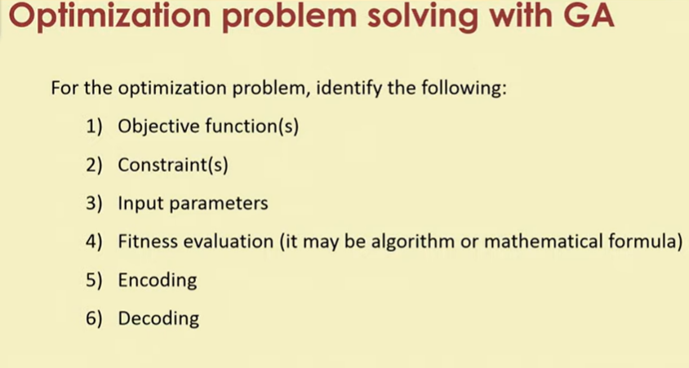

Slide 24
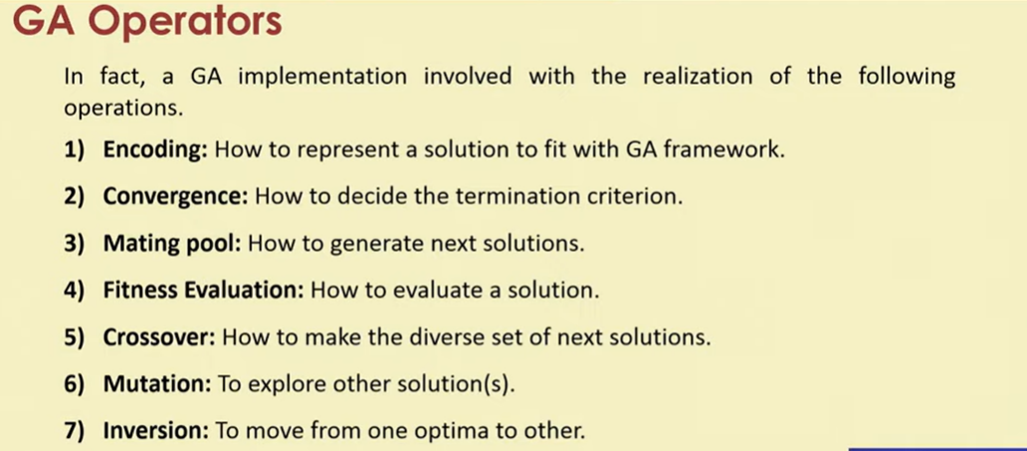

Slide 27
Holland, J. (1992), Adaptation in natural and artificial systems , 2nd Ed. Cambridge: MIT Press.
Davis, L. (Ed.) (1991), Handbook of genetic algorithms. New York: Van Nostrand Reinhold.
Goldberg, D. (1989), Genetic algorithms in search, optimization and machine learning. Addison-Wesley.
Fogel, D. (1995), Evolutionary computation: Towards a new philosophy of machine intelligence. Piscataway: IEEE Press.
Bäck, T., Hammel, U., and Schwefel, H. (1997), ‘Evolutionary computation: Comments on the history and the current state’, IEEE Trans. On Evol. Comp. 1, (1)
References
DISCOVER . LEARN . EMPOWER

Slide 28
Online Resources
http://www.spectroscopynow.com
http://www.cs.bris.ac.uk/~colin/evollect1/evollect0/index.htm\
IlliGAL (http://www-illigal.ge.uiuc.edu/index.php3)
GAlib (http://lancet.mit.edu/ga/)
DISCOVER . LEARN . EMPOWER

Slide 29
References
TEXT BOOKS
T1. Timothy J. Ross, “Fuzzy Logic with Engineering Applications”.
T2. S.N.Sivanandam, S.N Deepa, “Principles of Soft Computing”
T3. Lofti Zadeh “Fuzzy Logic and Soft Computing” Word Scientific, 1995.
T4 Samir Roy,Udit Chakraborty, “Introduction to Soft Computing:Neuro-Fuzzy and Genetic Algorithms”, Pearson.
REFERENCE BOOKS
R1. Bart Kosko, “Neural Network and Fuzzy Systems: A Dynamic System Approach to Machine” Prentice-Hall 1998
R2. Fausett, “Fundamentals of Neural Networks: Architectures, Algorithms, and Applications”, Prentice-Hall, 1994
R3. Jack M. Zurada, “Introduction to Artificial Neural Systems”, PWS Publishing Co., Boston, 2000.
R4. J S R Jang, “Neuro-Fuzzy & Soft Computing,”, Pearson.
DISCOVER . LEARN . EMPOWER

Slide 30
Journal Papers
1. C.A. Peña-Reyes. Evolutionary fuzzy modelling human diagnostic decisions. Annals of the New York Academy of Sciences, pages 190-211, May 2004. DOI – PDF
2. C.A. Peña-Reyes and M. Sipper. Evolutionary computation in medicine: An overview. Artificial Intelligence in Medicine, 19(1):1-23, May 2000. DOI
3. C.A. Peña-Reyes and M. Sipper. A fuzzy-genetic approach to breast cancer diagnosis. Artificial Intelligence in Medicine, 17(2):131-155, October 1999. DOI – PDF
4. Jungang Liu, Student Member, IEEE, and Oliver W. W. Yang, Senior Member, IEEE, “Using Fuzzy Logic Control to Provide Intelligent Traffic Management Service for High-Speed Networks”, IEEE TRANSACTIONS ON NETWORK AND SERVICE MANAGEMENT, VOL. 10, NO. 2, JUNE 2013.
Web links
(1) http://staff.cs.upt.ro/~todinca/cad/Lectures/cad_fuzzysets.pdf (2) Principles of Soft Computing
DISCOVER . LEARN . EMPOWER

Slide 31
THANK YOU
For queries
Email: monika.e11032@cumail.in

